Slide 1
Refugees/Immigrant Families
BY Abdullah Hassan

Slide 2
Context, Motivation, Method/Sources
As per the United Nations, 80+ million people displaced by the end of 2020.
Due to increase in Conflict, violence, persecution and human rights violations.
We’ll be looking at trends of Refugees before/after they resettle in United States.
This is my very own story since I came to U.S as a Somali Refugee back in 2004.
Data Analysis Method-Find Data-Cleaning and visuals in Excel & Power Bi.
Data sources include UNHCR, Migration Policy Institute, Department of State.

Slide 3
Terminology
A refugee is a person who has fled their own country for safety and security due to being at risk of serious human rights violations and persecution if they stay.
Refugee Camp-temporary facilities built to respond to specific emergencies. However, as these situations prolong, refugee stay for years or even decades.
Asylum-seeker is a one who has left their country to seek protection from serious human rights violations in another country, but not legally recognized a refugee.
Affirmative asylum processing involves your physical presence in the United States while defensive asylum is when requesting asylum to prevent removal.
Internally displaced persons(IDPs) due to conflict and violence in a country. IDPs mostly stay with their own countries & likely to get less international attention/help.
The United Nations High Commissioner for Refugees(UNHCR) is a UN agency mandated to aid and protect refugees, forcibly displaced communities, to assist in their voluntary repatriation, local integration or resettlement to third country.

Slide 4
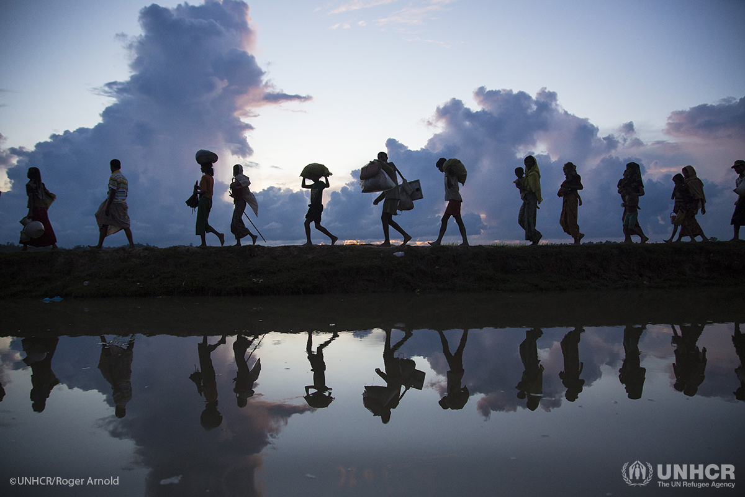
Journey Of A Refugee
Refugee will first likely Flee to neighboring host Countries.
These unable stay behind as IDPs.
Most end up in a Refugee Camp.
Some are sent back to his/her home country as Voluntary Repatriation.
Only 1% get to resettle in third country like U.S for Opportunities.
Since 1980, the U.S. has resettled more refugees than other country.

Slide 6
U.S. Refugee Ceiling & Resettlement

Slide 7
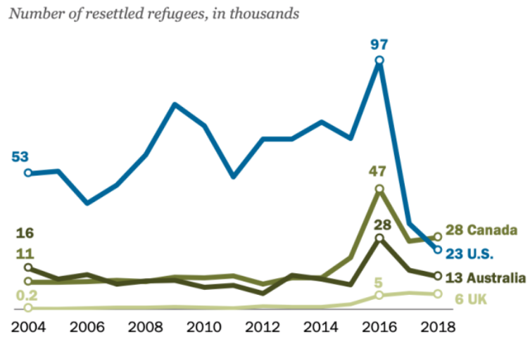
U.S. refugee resettlement drop
https://www.weforum.org/agenda/2019/06/canada-now-leads-the-world-in-refugee-resettlement-surpassing-the-u-s/

Slide 9
Resettlement to U.S by country-2004

Slide 11
Asylum Seekers

Slide 12
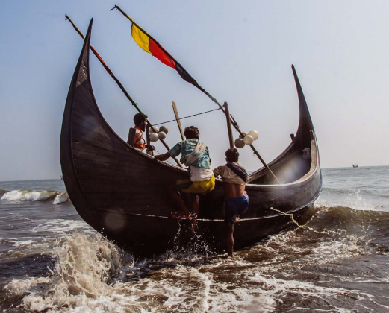
Refugees/IDPs Struggles/Resilience
While rate of Refugees, IDPS keeps going up.
Displaced face challenges fleeing their home.
By land, sea, or air with their lives in search for a place that offers safety & more opportunities.
Most end up in conflict zones especially IDPs.
Refugees/IDPs etc. likely suffer from P.T.S.D.
All got stories of their struggles and resilience.
These that get opportunity to resettle in U.S strive to integrate and give back in many ways.

Slide 13

More Finding/Recommendations
U.S was for long time 1st when it comes to funding & Resettling more Refugees overall.
Canada resettled more refugees(28,100) in 2018, since U.S passed the 1980 Refugee Act.
IDPS face most challenges in conflict zones.
More Access to clean water, Education HealthCare etc. for refugees and IDPs.
More options for Voluntary Return for refugees that can rebuild their countries.
Refugee, IDPs etc. is homelessness on global scale; we must start locally to find solutions.
https://www.unhcr.org/609553414/world-refugee-day-2021-toolkit-pdf

Slide 14




Local and International Refugee Agencies
Local:
International:

Slide 15
References & Articles
https://www.wrapsnet.org/admissions-and-arrivals/
https://www.migrationpolicy.org/proghttps://immigrationforum.org/article/fact-sheet-u-s-refugee-resettlement/rams/data-hub/charts/immigrant-population-over-time
https://www.dhs.gov/immigration-statistics/refugees-asylees
https://www.weforum.org/agenda/2019/06/canada-now-leads-the-world-in-refugee-resettlement-surpassing-the-u-s/
https://data.humdata.org/search?q=Syria+Refugee+Camps&page=3https://www.weforum.org/agenda/2019/01/from-a-refugee-camp-to-davos-one-co-chair-s-story
Thanks for your time!

